Slide 1

Introduction to Profiles and Different Types of Profiles
35698 - Bharath mummadi

Slide 2
What is Profiling?
Profiling means monitoring and analyzing application performance.
It helps detect bottlenecks, memory leaks, and performance issues.
Provides insights for optimization.

Slide 3
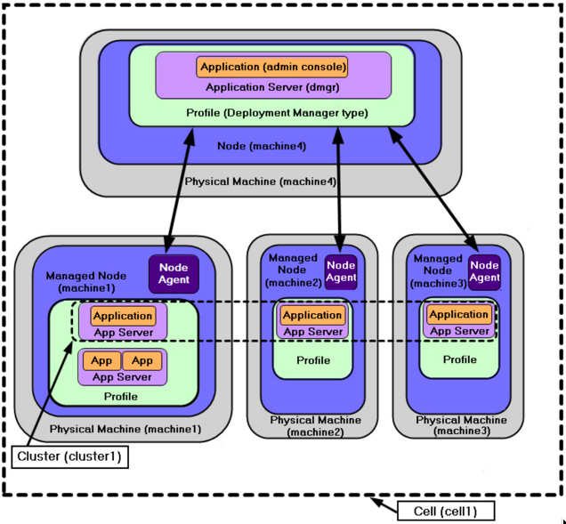
How profiles work?
One physical server can host multiple profiles
Each profile has its own JVM, logs, and configuration
Profiles provide isolation for testing, production, and administration

Slide 4
Types of Profiling
CPU Profiling – checks CPU usage, detects bottlenecks.
Memory Profiling – tracks memory allocation, leaks, and usage.
Thread Profiling – monitors thread states and concurrency.
Garbage Collection Profiling – analyzes GC logs and pauses.
Class/Method Profiling – finds slow methods or inefficient code.

Slide 5
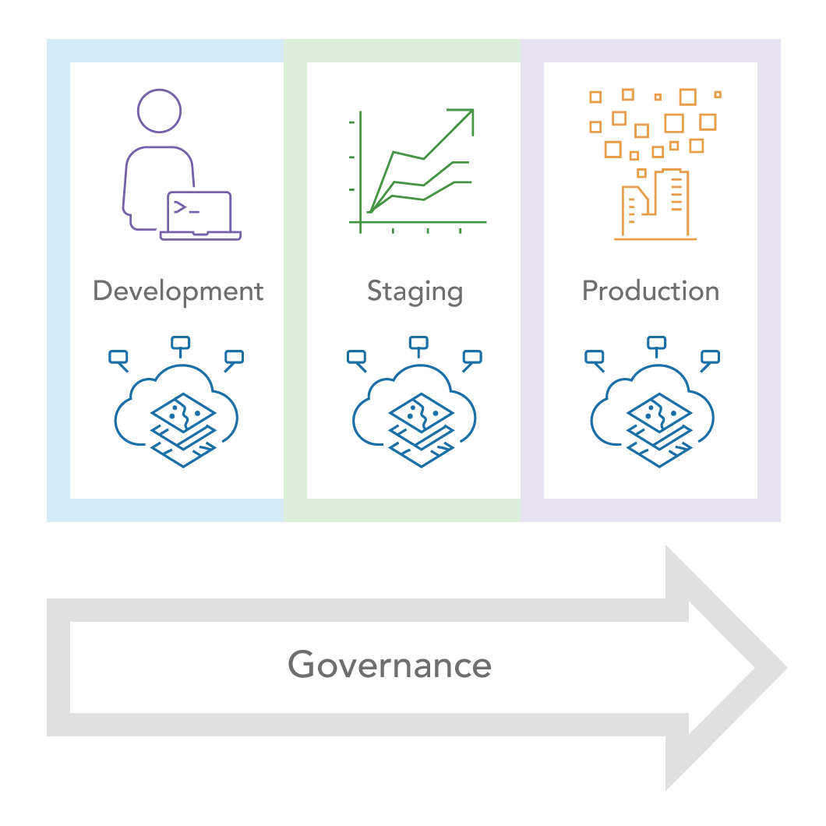
Why Profiles are Important
Provide isolation between environments.
Allow multiple instances of server on the same machine.
Simplify management of applications.
Help in testing and production separation.

Slide 6
Examples of Use
Standalone developer: Uses default or custom profile.
Large enterprise: Uses managed and cell profiles.
Testing team: Runs multiple custom profiles with different JVM settings.

Slide 7
Profiling Tools
VisualVM – open-source, integrated with JDK.
JProfiler – commercial tool with deep analysis.
JConsole – bundled with JDK for monitoring.
Jstat – command-line monitoring for JVM stats.
Jstack – analyzes thread dumps to detect deadlocks.

Slide 8
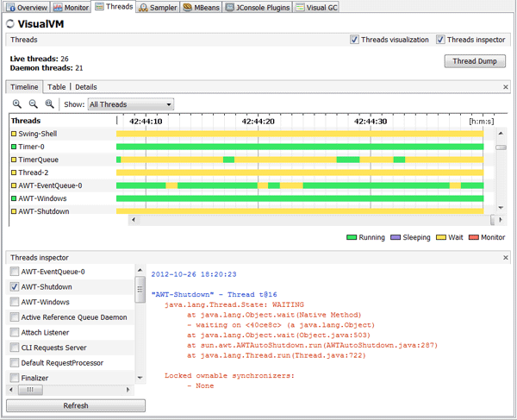
Example of Java visual VM

Slide 9
Thank you

